Slide 1
Check-in Meeting Nominating Committee Chairs
CPF Network Risk Management Oversight
July 2021

Slide 2
Welcome Introductions - Who is online today Agenda
Understanding the Bylaws:
Terms of Service for Directors and Officers.
2 Standing Committees - Bylaws, Nominating.
Roles of the Board – there are 5 specific roles to fill: P, VP, Treasurer, Chair of Bylaws, Chair of Nominating Committee.
Understanding the Roles on a Governance Board.
Role of the Chair of the Nominating Committee.
Clear Expectations and High Visibility for the “Call for Interest”
Tools available, samples of documents
Branch Support available
Wrap-up
Timeline in relation to the Branch AGM - Network Orientation for all Branch Board members on September 10th 2021 (virtual).
Questions, Challenges to Address / Requiring Support over the Summer Months.

Slide 3
Understanding the CPF Bylaws – as they relate to nominating process
Branch Board minimum is 5 people – range 5 to 7, 5 to 9.
Two Standing Committees - Bylaws, Nominating.
Roles: President, Vice President, Treasurer, Chair of Bylaw Committee, Chair of Nominating Committee (Canada – minimum of 3: P, VP, T).
Nominating Committee: consists of 3 to 5 people. Chair of Committee is from the Board; at least 2 others that are not from the Board (Members at large or Chapters).
Annually at Board Meeting : Review description of roles and intentions with current Board
Terms of Service … Create a chart to review with Board once per year prior to Nominating Process getting underway. Clear intentions for succession into next roles.
Skill Sets and EDI … Add details of “who” is remaining on your Board, what knowledge skills and representation gaps are showing?
List of “potential candidates” to brainstorm of those known to the Board’s Networks (personal and professional)

Slide 4
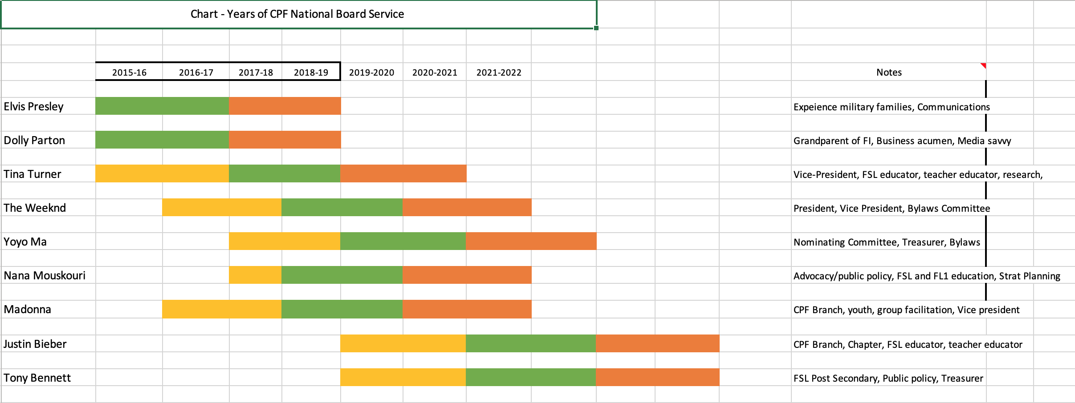

Slide 5
Understanding the Roles on a Governance Board
Understanding the Roles on a Governance Board : Important they understand they are joining a Board to fulfill one of these roles and not programming or operations (which is done by staff). Experience on other Governance Boards is an asset.
Communications (President) - Media, Stakeholders, Partners, Funders
Advocacy (Vice President)
Risk Management - Financial and Legal (Treasurer and Bylaw)
Succession Planning (Nominating)
Role of the Chair of the Nominating Committee:
Review Composition of Nominating Committee.
Review Selection Process - transparency; equity, record keeping.
Review Tools, samples of documents: Assessment Grid, Interview Questions, etc.
Call the meetings of the Committee : a) initial review; b) review of selection process; c) selection (interviews) and decisions; d) debrief of process, approve report to Board.
Role of the ED – Support to Chair, Committee – not involved on Committee or in selection process. Staff completes the communications tasks on behalf of the Committee.

Slide 6
“Call for Interest” – Publicly distributed, Posted – Increases our Visibility
Write the ‘Call for Interest’ – include specific targeted skills or needs to complement the Board; provide details as to expectations for commitment; include specific roles that need to be filled. (Samples available)
Describe Clear Expectations: ex., 4 Board meetings per year, with monthly calls; chairing one committee with 4 meetings per year, etc.
High Visibility for the “Call for Interest” - outreach, distribution, posting broadly, “shoulder tapping”, etc.
Where are you sharing this? CPF communication vehicles – social media, website, newsletter;
Partner and Community communication vehicles: Immigrant Resource Centres, Volunteer Sector organizations / listings…
All CPF member email + include stakeholders (funder) in your distribution list.
Shoulder Tapping: Personal emails to list of potential candidates; Encourage others to also extend emails to contacts.

Slide 7
Applications Requirements
Membership is not required prior to being selected. Must become a member when successful. Extend the Call for interest far beyond our membership.
Ensure they consider that the role on the Branch Board working with professional, paid staff is very different than a Chapter Executive volunteer leader who is “working” directly on projects and programs. This is important to explain as individuals may be transitioning from one role to another.
Do they understand the difference and role of a Governance Board as different from a previous role on Chapter?
Do they understand the level of commitment – number of meetings per year; and the type of work done on the Board?
Would they be better suited or able to support CPF on a committee (program focused)?
Consider availability of a Mentor, past Board person to offer support, guidance, share insights and experiences.

Slide 8
Candidate Selection Process
Committee Meeting to review the tools used, to ensure understanding of the steps / process by all committee members, timeline and deadline dates.
What is the AGM date? Work backwards according to the timeline set in the Branch Bylaws.
Transparent Process – Is your process written out clearly if anyone asks? Can you provide the assessment grid if requested? Ensure all applications treated equitably.
Assessment Grid – Review and ensure it prioritizes your needs for the coming year(s). (Samples available).
Committee reviews all applications - letters, resumes, other. Usually consider applications individually then come together to share results.
Chair is responsible for the report to the Board, and to the members at the AGM; for communicating with all candidates on status of applications.
Thank you letters, media releases can be communicated by ED or staff. Branch Support available: writing / communications staff; Liaison from National Nominating Committee.

Slide 9
Wrap-up
Checklist:
Timeline in relation to the Branch AGM - Network Orientation for all Branch Board members on September 10th 2021 (virtual).
Questions, Challenges to Address / Requiring Support over the Summer Months.
Thank you for taking the time to meet today!

